Slide 1
vCore Analysis
Mulesoft system Architecture

Slide 2
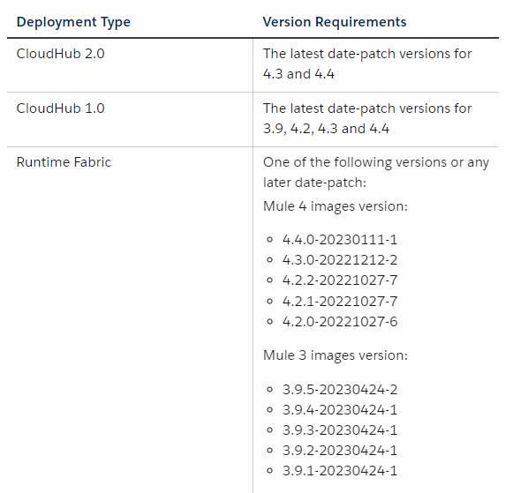
Usage Based Model
Applicable to Cloudhub 1.0
Applicable to Cloudhub 2.0
References
https://docs.mulesoft.com/general/pricing#supported-mule-runtime-versions

Slide 3
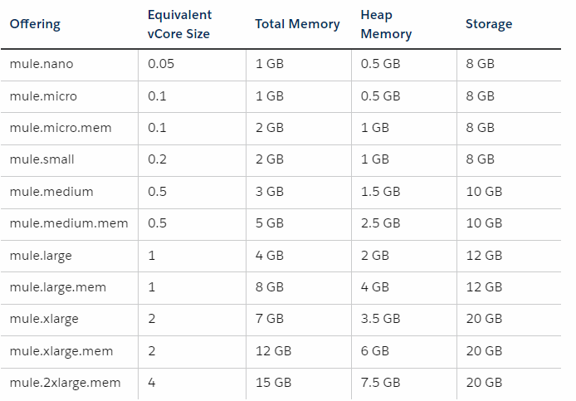
vCores: Cloudhub 2.0
Usage Based Model
Nano is a new offering (0.05 vCore)
Legacy Model
vCores [0.1, 0.2, 0.5, 1, 1.5, 2, 2.5, 3, 3.5, 4]
Usage based model vcore offerings
References
https://docs.mulesoft.com/general/pricing#cloudhub-2-0-application-deployment

Slide 4
Usage Based Model : Usage
Characteristics
Predictable fluctuation in demand based on seasonal sales and promotions
Products with features that can easily scaled up or down as the needs of a customer change are ideal candidates assuming cost can be borne by Customer
Usage(reduce costs) based upon current needs ; rather than design for future ; increase pool of available vCores
Varying usage pattern (can be challenging to accurately predict their usage needs)
References
https://blogs.mulesoft.com/news/horizontal-autoscaling/
https://userpilot.com/blog/usage-based-pricing/

Slide 5
Usage Based Model : Usage
Usage Based Pricing (UBP) can lead to uncertainty in bills
Product | Metric Description | Usage Details
Mule Runtime | Mule flow: A flow within a deployed and running Mule app that contains a Mule event source or route APIKit request. | Flows are aggregated using a Max Concurrent model. The usage for a month is the highest number of flows that exist in a single given hour during a month.
 | Mule message: The container of the core information processed by the runtime. | A Mule message counts as a single unit when an event source triggers it. Messages are aggregated using a sum of all messages sent during a month.
 | Data throughput: The total amount of data transferred in and out of the infrastructure that runs Mule where the Mule app is deployed. | Data throughput counts when the deployed application transfers data to execute its business logic, including but not limited to internal operational network traffic for monitoring, logs, and health checks. Data throughput is aggregated as a sum of all bytes during a month.
Open Questions
Are sub-flows considered as distinct flow ?
Can cost be optimized by using one big flow ?
What is the pricing for: Per flow ; Per message ; Data throughput size
Does Usage Base Pricing imply unlimited core availability ? Is there a cap?
References
https://blogs.mulesoft.com/news/horizontal-autoscaling/
https://docs.mulesoft.com/general/pricing-metrics
https://userpilot.com/blog/usage-based-pricing/

Slide 6
Usage Based Model : Usage
Usage Based Pricing (UBP) can lead to uncertainty in bills
Open Questions
Are sub-flows considered as distinct flow ?
Can cost be optimized by using one big flow ?
What is the pricing for: Per flow ; Per message ; Data throughput size
Does Usage Base Pricing imply unlimited core availability ? Is there a cap?
If your applications require more vCores than are available, CloudHub 2.0 allows you to create the application, but you cannot start it until the additional vCores become available. To increase vCore allocation, stop or delete an application or contact your account manager to increase your subscription’s vCore allocation. - NON USAGE BASED ??
Assume Bursting applies to Cloudhub 2.0 . Validate this
References
https://blogs.mulesoft.com/news/horizontal-autoscaling/
https://docs.mulesoft.com/general/pricing-metrics
https://userpilot.com/blog/usage-based-pricing/

Slide 7
Mule Considerations
When to reconsider implementing in MuleSoft
No Transformation: If MuleSoft primarily serve as pass throughs to back end systems
No Orchestration: Company wants to gain insights into traffic patterns, response rates. Such case need single workflow to move API call data to a monitoring dashboard without any orchestration of data.
require staff with MuleSoft development/operational skills to deploy and manage, if org lack such staff its practical to consider alternatives
Very few chances of re-use
Cost of licensing and maintaining MuleSoft is not justifiable by value it brings
Asynchronous patterns
Certain scenarios where ultra high performance is critical, overhead introduced by integration platform (Mule) might be bad. Direct integration in low-level language might be necessary

Slide 8
Autoscaling in Cloudhub 2.0
Applicable only for Usage based model
Cost of autoscaling depends upon: resources and number of replica
Configuration:
Runtime manager -> deployment config ( Runtime tab) -> check the option for "Enable CPU based Horizontal Scaling“
define min and max number of replicas - (need atleast two for HA)
configure replica size (micro, micro.mem, small)
deploy application
References
https://docs.mulesoft.com/cloudhub-2/ch2-configure-horizontal-autoscaling

Slide 9
Performance consideration for successful HPA
Apps that scale up on CPU usage are a good fit for CPU based HPA (horizontal Pod Autoscaler)
https app with async req
app with low latency and high throughput
app with a lot of dataweave transformations
Apps that don’t have built in parallel processing, app with low throughput and high latency with large request are not good for CPU based HPA

Slide 10
Autoscaling in Cloudhub 1.0
To enable autoscaling in Cloudhub need to have Enterprise License Agreement
References
https://docs.mulesoft.com/cloudhub/autoscaling-in-cloudhub

Slide 11
Transaction in Mulesoft
Transaction typically defined as specific unit of work that is processed by Mulesoft platform. Which includes action like API Calls, data preprocessing even and integration flows.
References
https://docs.mulesoft.com/mule-runtime/latest/transaction-management

